Slide 1
Double Up Food Bucks Grocery Webinar
Double Up Team | 25 May 2021
Notes:
Intro slide
CW
Thank you.
Honored to be here today
Self-introductions per person
Excited to gather with all of you. We hope you are all doing well and staying healthy. We want to begin by thanking all of you for participating in Double Up during this time. Your partnership has been so important to the communities that you serve.

Slide 2
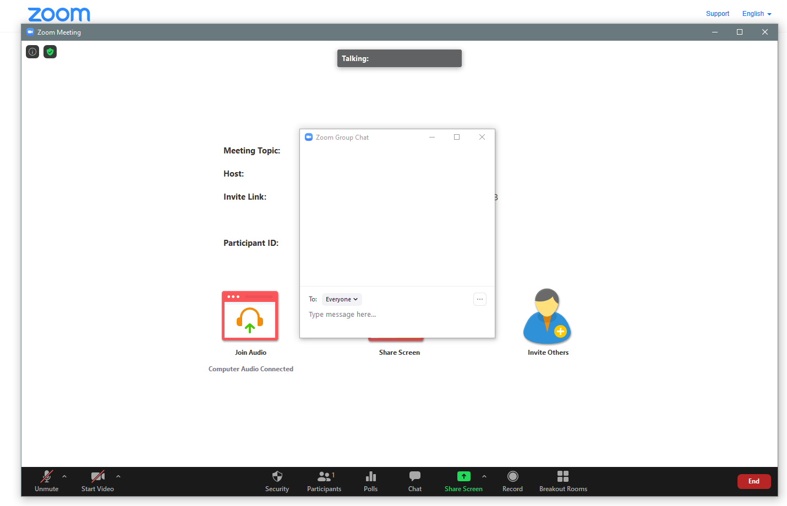
Notes:
CW
A little House Keeping before we get started
Zoom controls are along the bottom of the window
Use the microphone icon, To mute and Unmute yourself
Using the chat box to ask questions
Put the name and store in the chat box

Slide 3
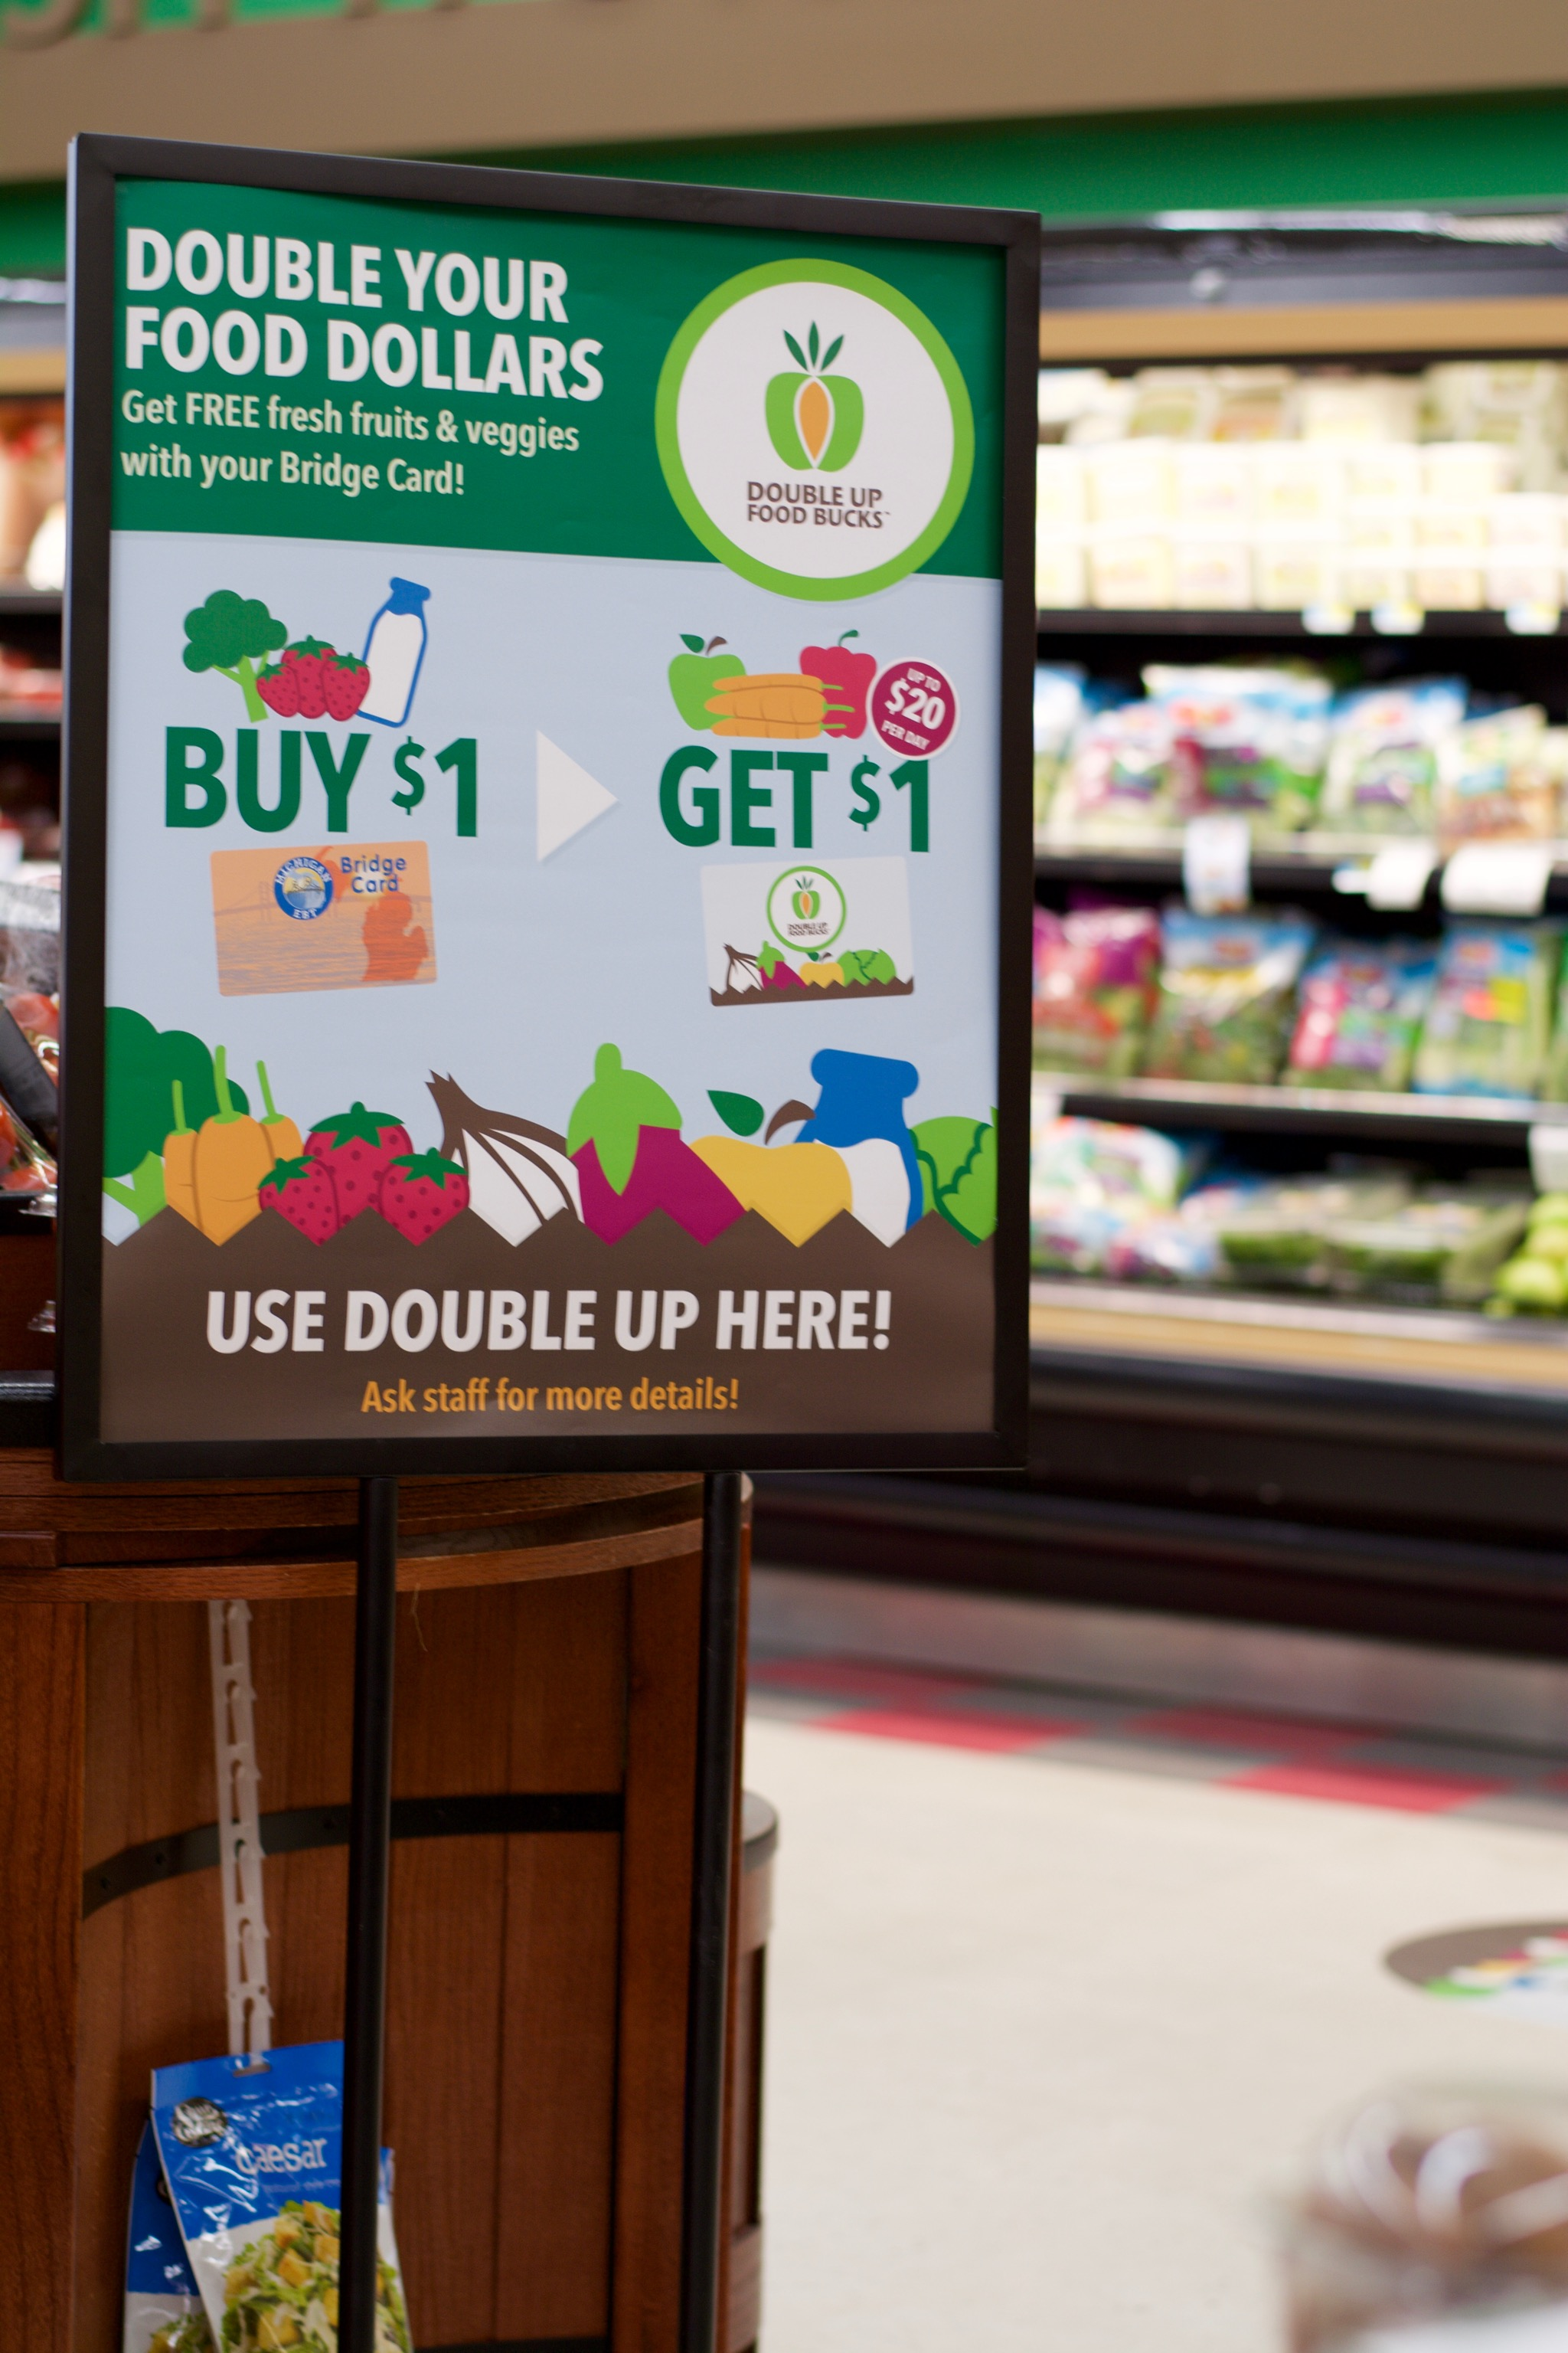
Today’s Agenda
    Welcome
    P-EBT
    Double Up First Quarter Results
    Taste the Local Difference
    Double Up Tech Talk
    Outreach & Engagement
    Retailer Questions
Notes:
CW
Agenda
Welcome CW
House Keeping CW
P-EBT
Taste the Locate Difference
Double Up First Quarter Results
Tech Talk
Our New Community Engagement Manager
Retailer Questions

Slide 4

P-EBT and Double Up Impact
Notes:
CW?
P-EBT
Michigan’s new round of P-EBT has arrived and is providing temporary food assistance benefits to families with school aged children that are eligible for free and reduce priced lunches.
Pandemic EBT is eligible to earn in the DU program the same as the EBT card
P-EBT has been very impactful to our program
This has caused a massive surge in program reach and use largely double-digit growth in most locations
Our website use has increased along with program usage
DU and P-EBT has been a benefit to families around the state.
Summer Season
More robust Michigan produce will arrive in store, so remember to bring in more MI produce
Prepare for MI produce season as we prepare to measure your MI produce % from July1-Nov 31
Summer Season
More robust Michigan produce will arrive in store, so remember to bring in more MI produce
Prepare for MI produce season as we prepare to measure your MI produce % from July1-Nov 31

Slide 5
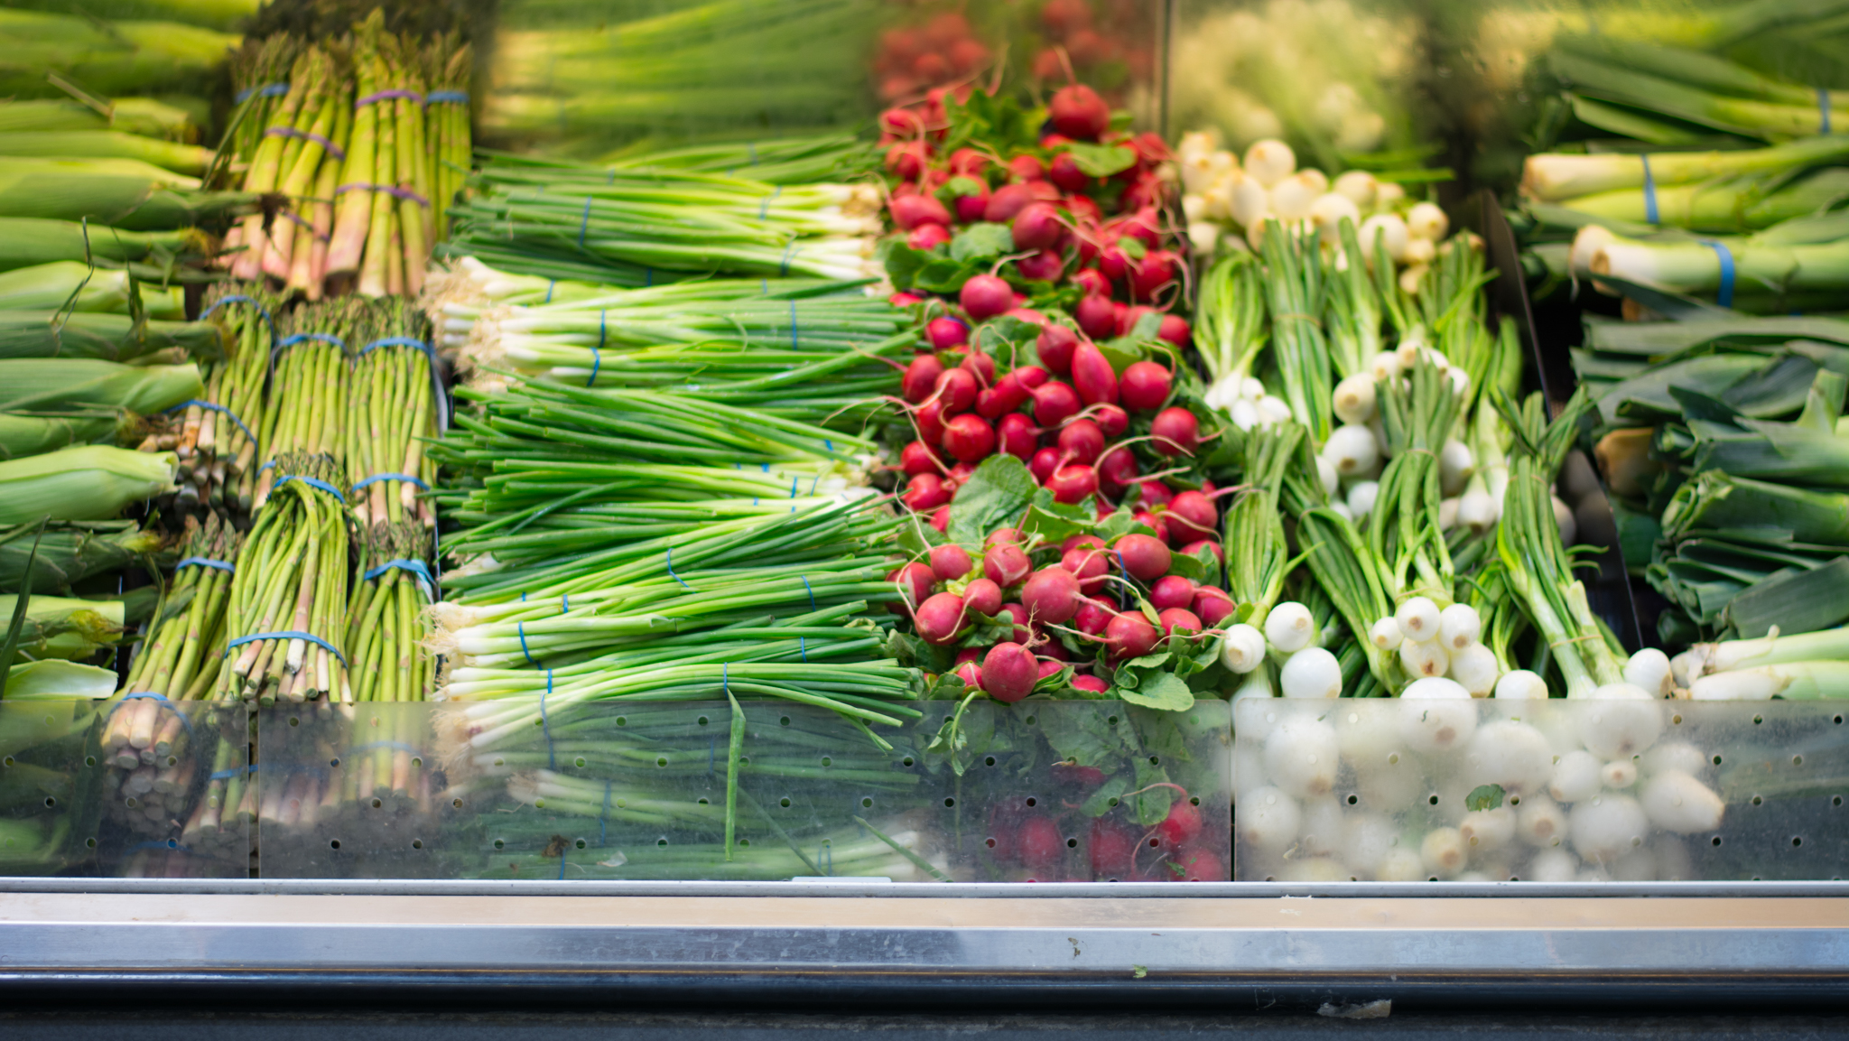
Reporting
Kendra Valkema
Information Manager
kvalkema@fairfoodnetwork.org
Notes:
KV

Slide 6
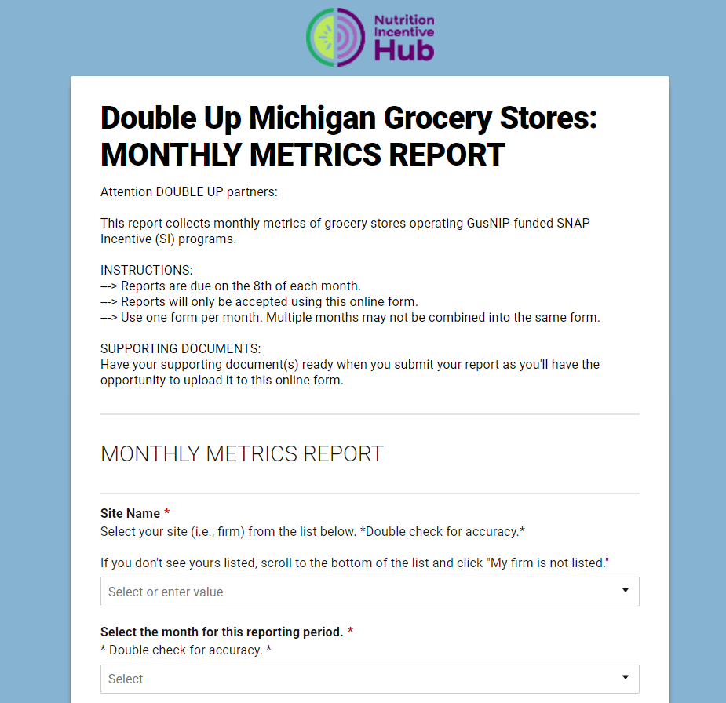
Monthly Reports
Online form due by the 8th of every month
Reports must include the supporting documents for all dollar amounts
Please submit one report
  If you need to change a report after submitting, contact Kendra at kvalkema@fairfoodnetwork.org
Notes:
KV
Online form due by the 8th of the month every month
Reports must include the supporting documents for all dollar amounts
Please submit one report
If you need to change a report after it has been submitted, contact Kendra at kvalkema@fairfoodnetwork.org

Slide 7

On Time Monthly Reporting
Why accurate reports are needed on time:
To accurately reimburse you.
To track the progress your store is making on your contract.
If Double Up spending is higher than expected at your store, we will increase your contract amount.
Notes:
KV
We need an accurate report to reimburse you for Double Up redeemed at your store every month
We also use this report to track the progress your store is making on your contract
If Double Up spending is higher than expected at your store, we will adjust your contract to make sure shoppers can continue to redeem Double Up at your store

Slide 8
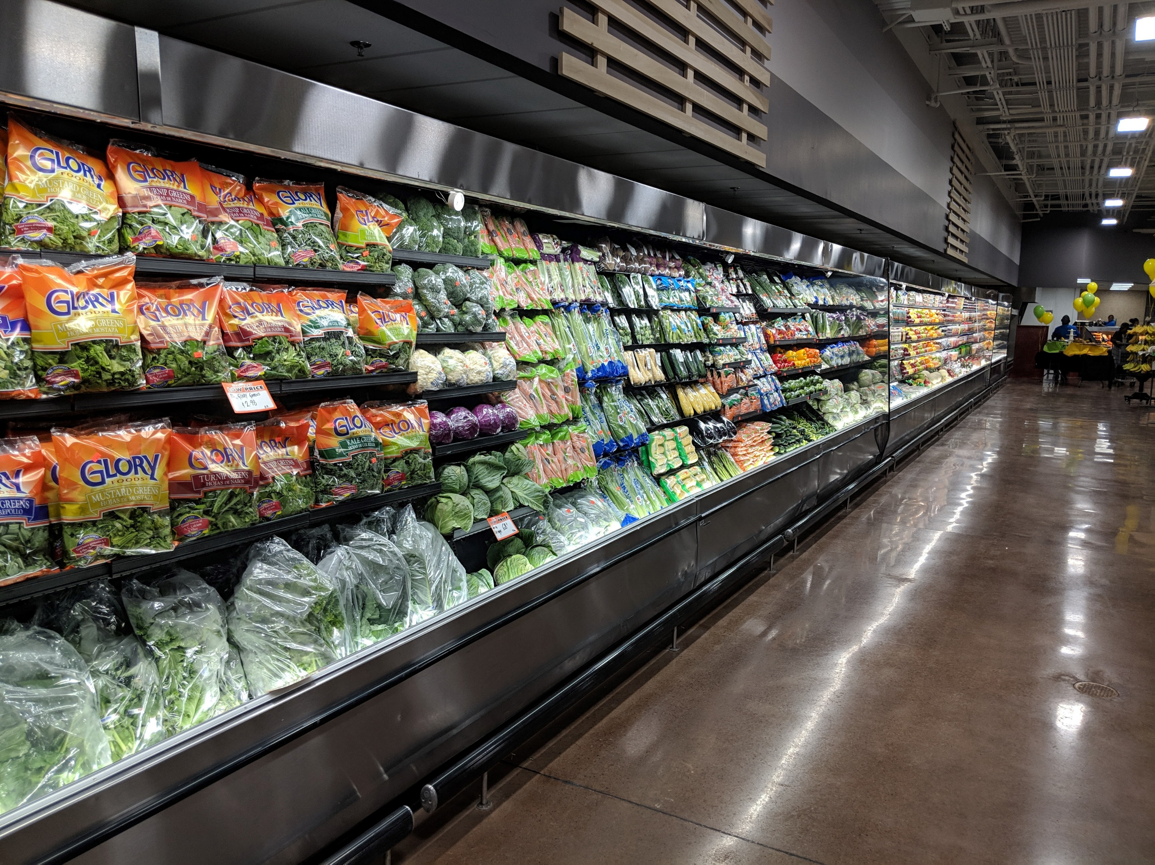
New Annual Report
Annual Report replacing quarterly report.
One-time report due near the end of summer.
More information coming soon!
Notes:
KV
This will be due one time near the end of summer. We will provide more information about this report as soon as we can.

Slide 9
COVID’s impact
Last year your stores saw record Double Up activity.
We are continuing to see that trend in both earning and spending.
The earning limit is still lifted.
We encourage you to find ways to engage your shoppers to spend Double Up they have earned.
Notes:
KV
Last year your stores saw record Double UP activity. We are continuing to see that trend in both earning and spending.
The earning limit has not been reinstated, but we encourage you to find ways to engage your shoppers to spend Double Up they have earned.
Last year your stores saw record Double UP activity.
We are continuing to see that trend in both earning and spending.
The earning limit has not been reinstated, but we encourage you to find ways to engage your shoppers to spend Double Up they have earned.

Slide 10
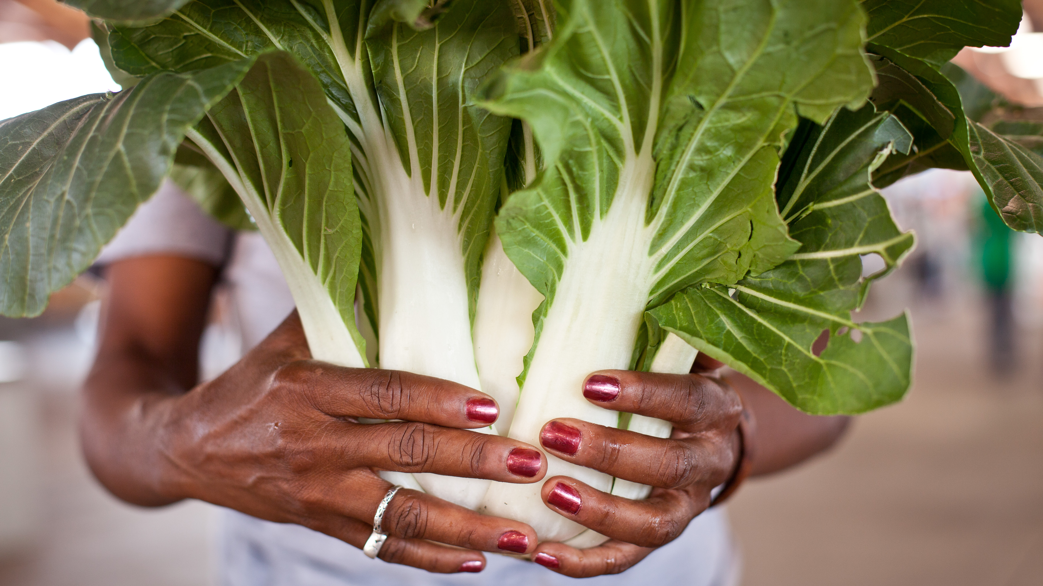
Local Produce Reporting
Required year round
From July – November, there is a 20% local sourcing requirement to participate in the program
Local = Grown in Michigan
If your store has questions or concerns, we want to help you!

Slide 11
Assistance for Retailers
Michigan Good Food Fund may be able to help with equipment upgrades or merchandising assistance
Taste the Local Difference partnership with Fair Food Network.
  Focused on Southeast Michigan in 2021
  Identify opportunities for stores to work with local farms & vendors
  Access to a statewide network, rich with knowledge & resources
Notes:
The Michigan Good Food Fund may be able to help your store with equipment upgrades or merchandising assistance
Taste the Local Difference has partnered with Fair Food Network to help identify opportunities for stores to work with local farms and vendors in Southeast Michigan but also has a statewide network rich with knowledge and resources

Slide 12
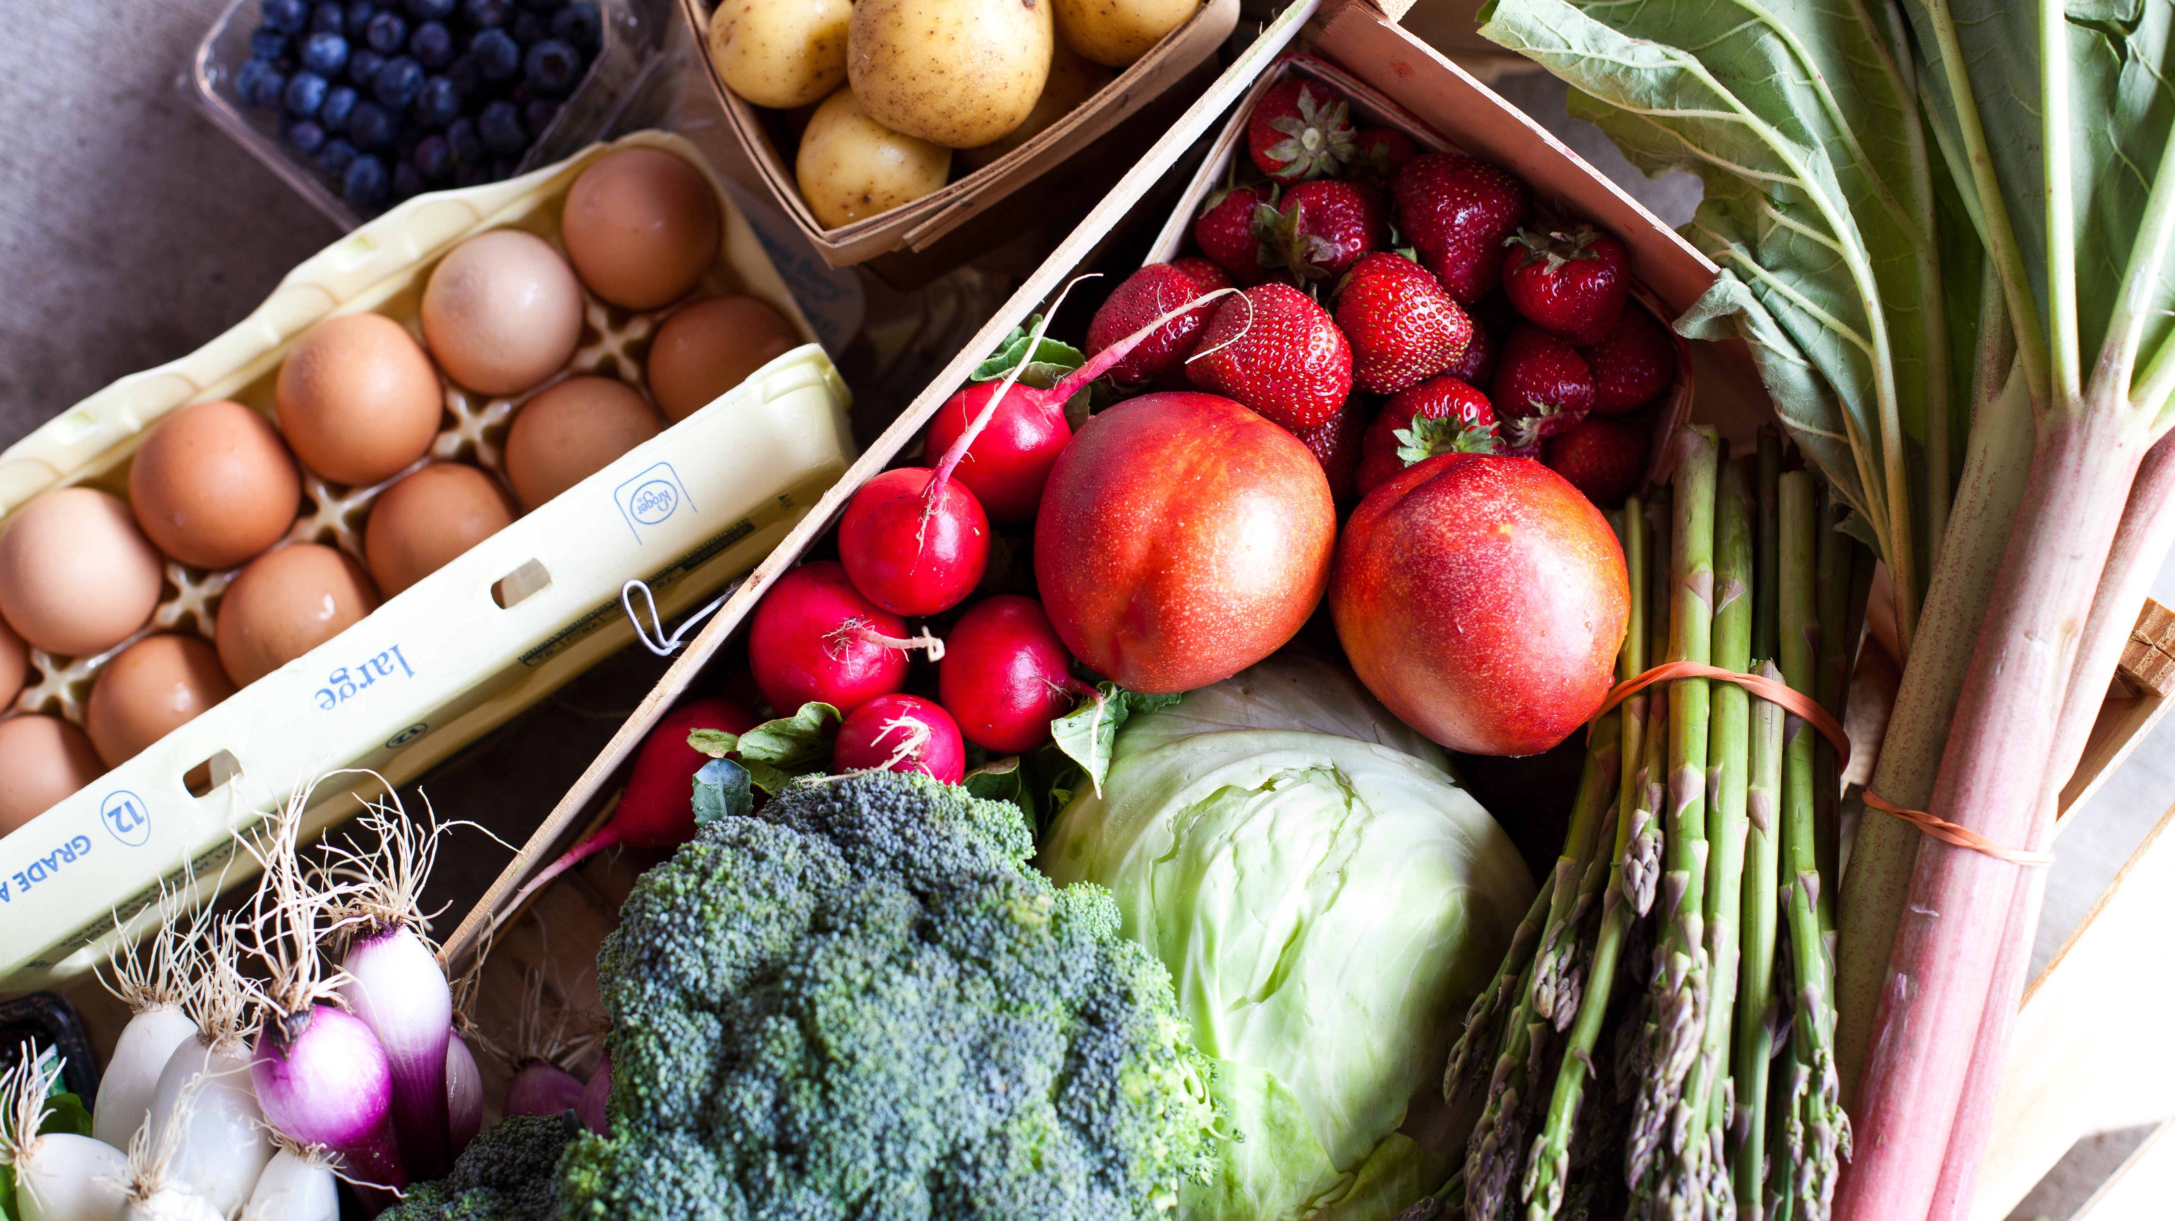
Taste the Local Difference

Slide 13
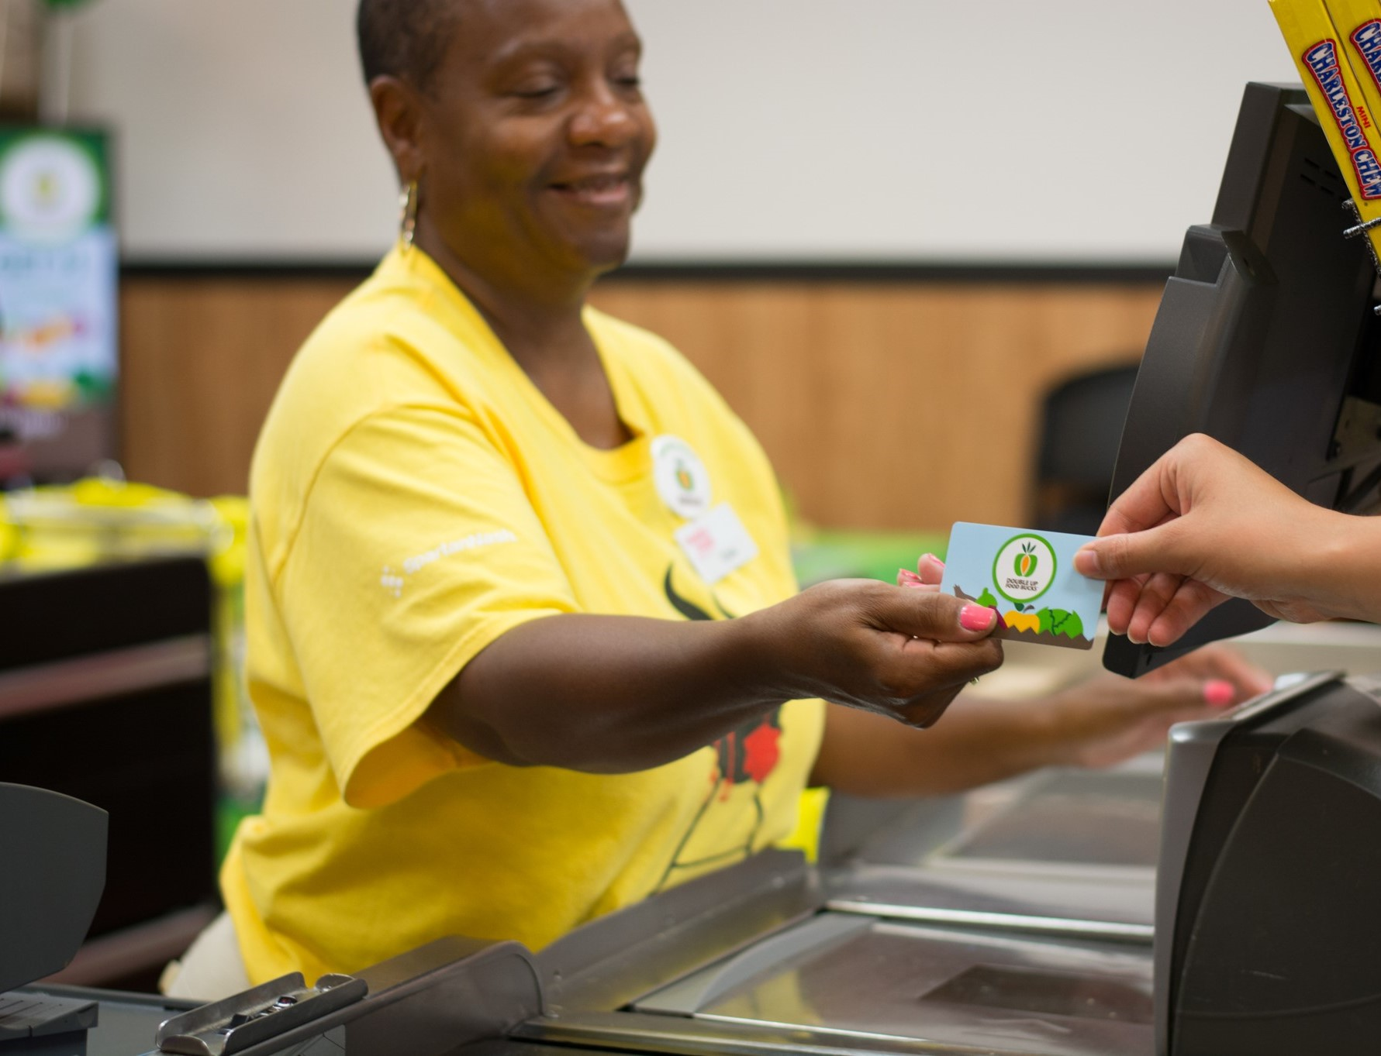
Double Up Technology Opportunities
Double Up Card + LOC Registers
  Simple Software Installation
  Seamless Transaction Process
  Let us know if you are interested
Inmar Pilot
  Looking for retailers to participate
  Improved Transaction Flow
  Works with:
    NCR: ISS45, ScanMaster, ENCOR, ACS-IR, Storeline
    IBM SA, IBM ACE
    RORC

Slide 14
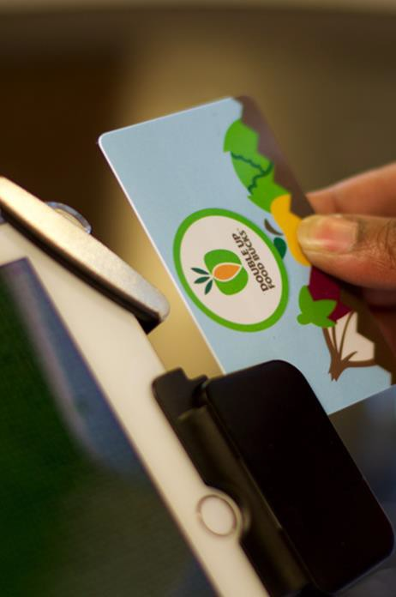
Double Up Card Technology
Benefits
  Shopper’s balance is never lost
  Counts to the penny, no rounding
  No counting coupons! Automatically tracks transactions.
  Easy to use reporting features
  Works with LOC registers

Slide 15
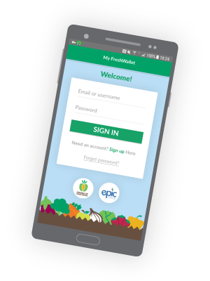

Double Up Card & “my Fresh Wallet” App | Check Balance
Designed to work with the Double Up Card

Slide 16
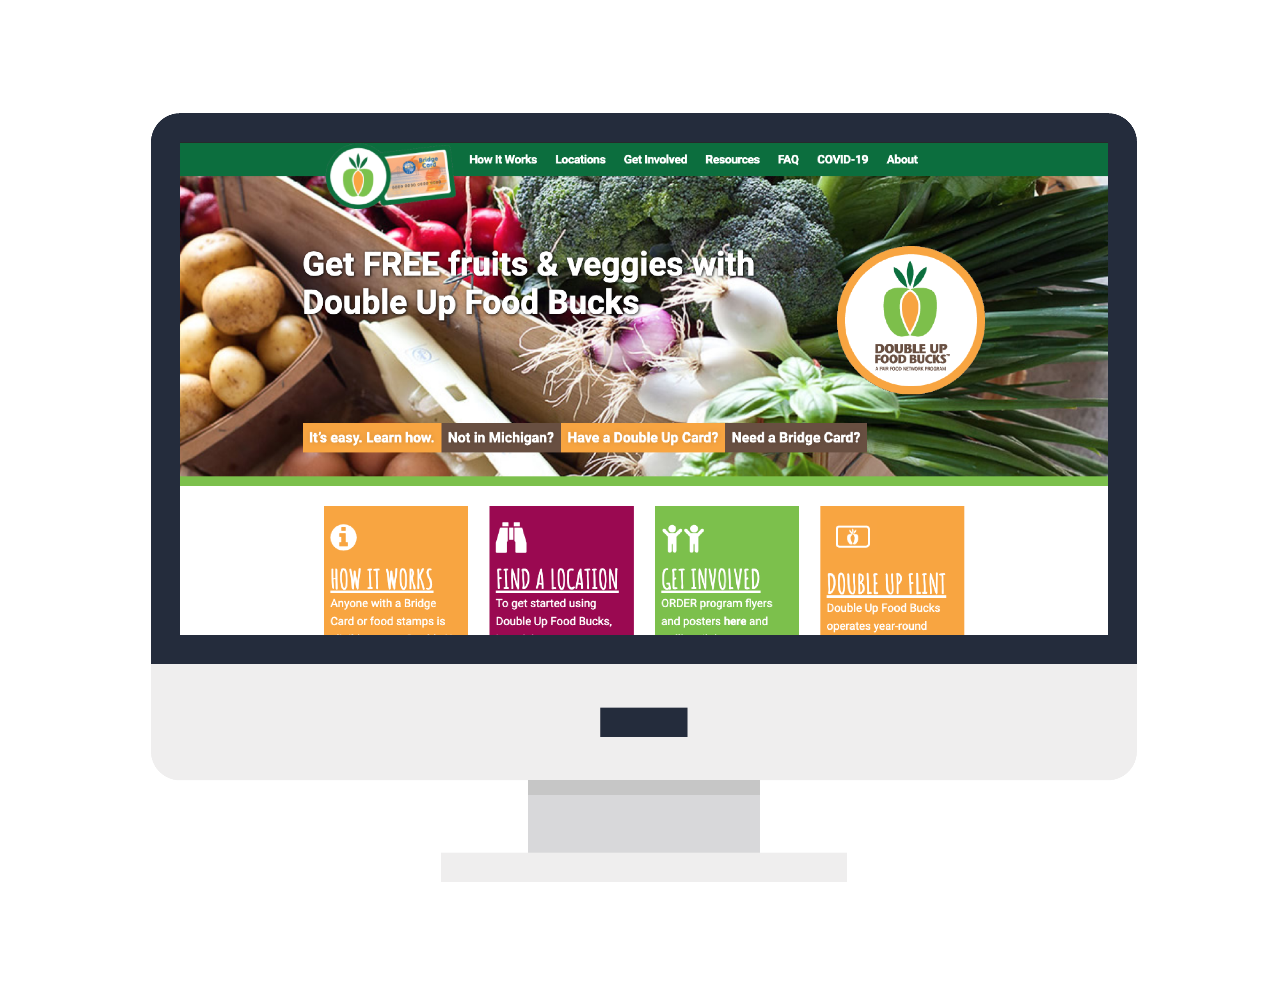
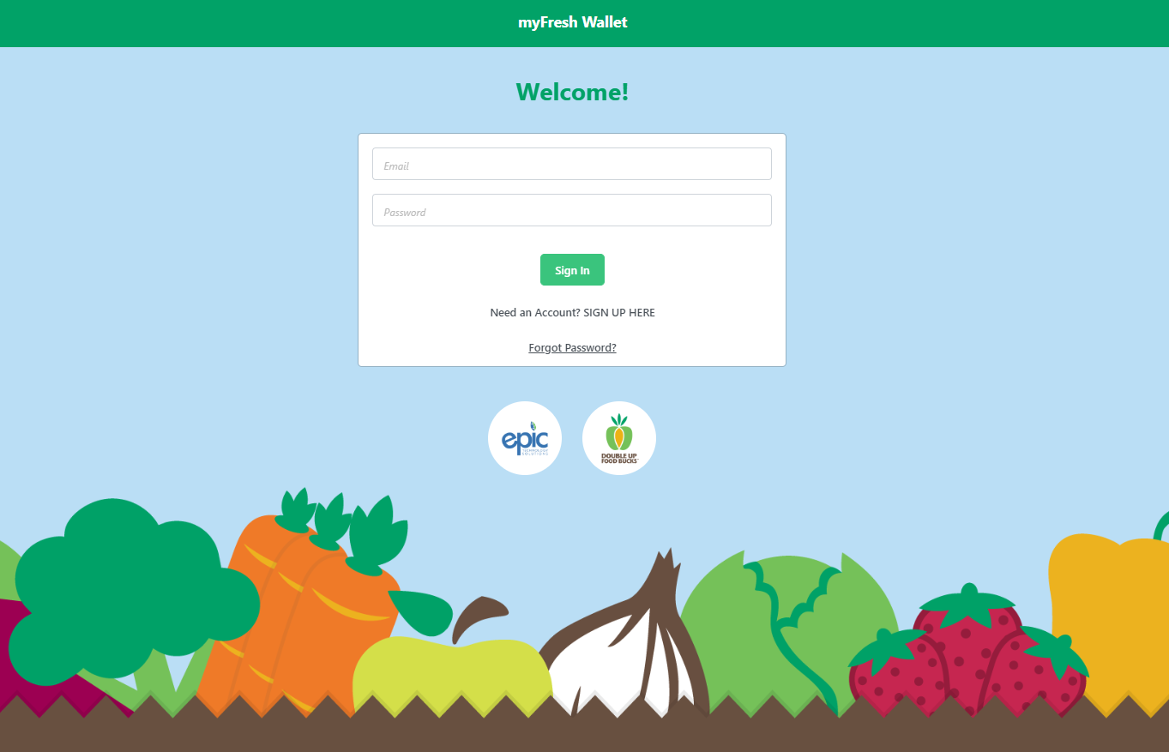
Double Up Card| NEW Self-Enrollment Features for Shoppers
Enroll Online: myDoubleUp.com
Download
The Double Up
Mobile App:
My Fresh Wallet

Slide 17

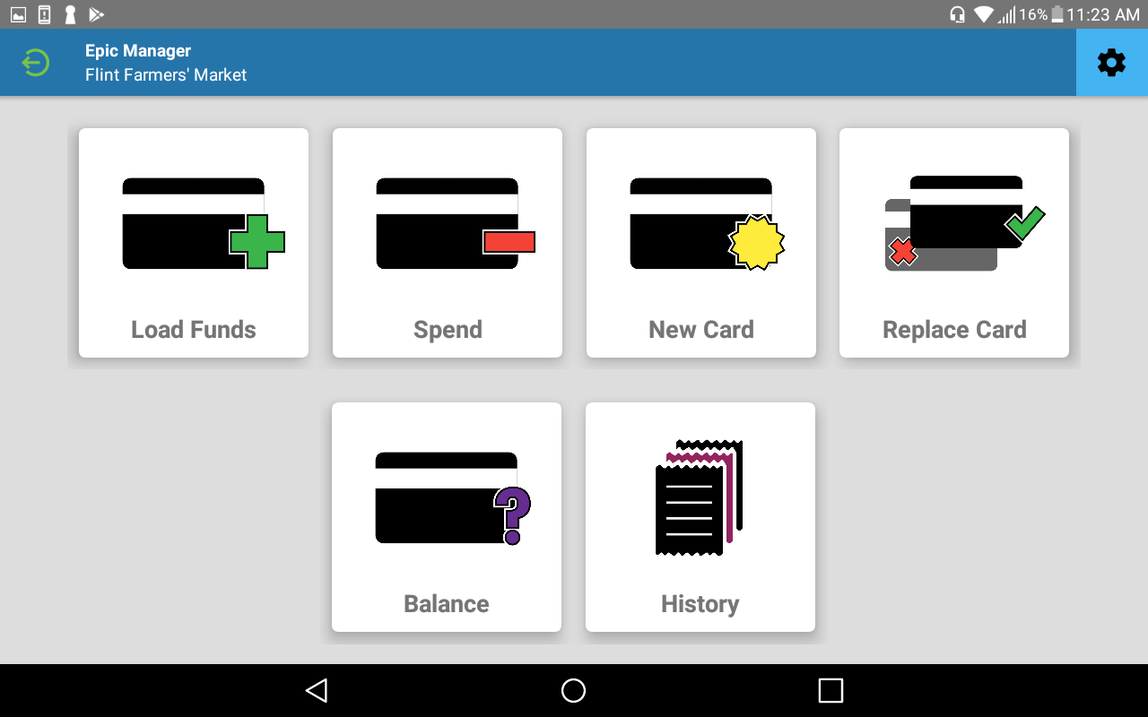
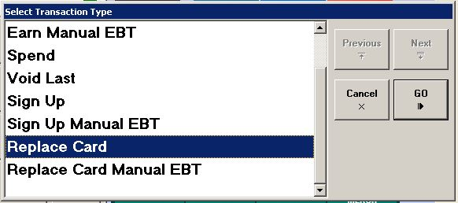
Double Up Card| Provide a Card for Self-Enrolled Shoppers
Use ‘REPLACE CARD’ Function
Fresh Incentives App
LOC Registers

Slide 18

Communication & Outreach
  Marketing Material
  Website: DoubleUpFoodBucks.org
  Social Media
  Statewide Partner Networks
  Hotline: 866.586.2796
  Info@DoubleUpFoodBucks.org
Notes:
CS
Here are a lot of the general outreach and communications we provide
Unified brand and marketing materials
Website with online location finder
hotline #
advertising including: Google and Facebook ads targeting key zip codes, radio ads.
In early years, also did billboard, bus ads/
Also share signage with stores

Slide 19
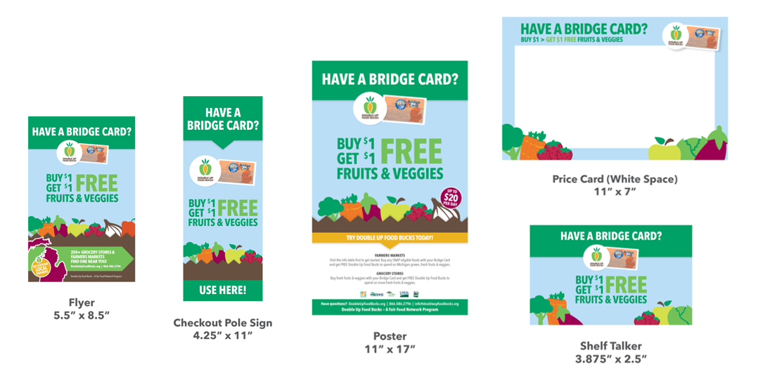
Double Up Food Bucks |Marketing Materials
Need Materials? Request Here: https://doubleupfoodbucks.org/get-involved/get-double-up-materials/
Notes:
CS
We have a variety of Marketing materials to fit your store needs, available including:
Window & Stanchion Signs
Big Outdoor Banners
Flyers – these are great to have at check stands to use as bag stuffers or provide anytime a customer uses their bridge card
Many of our materials are available in multiple languages.

Slide 20
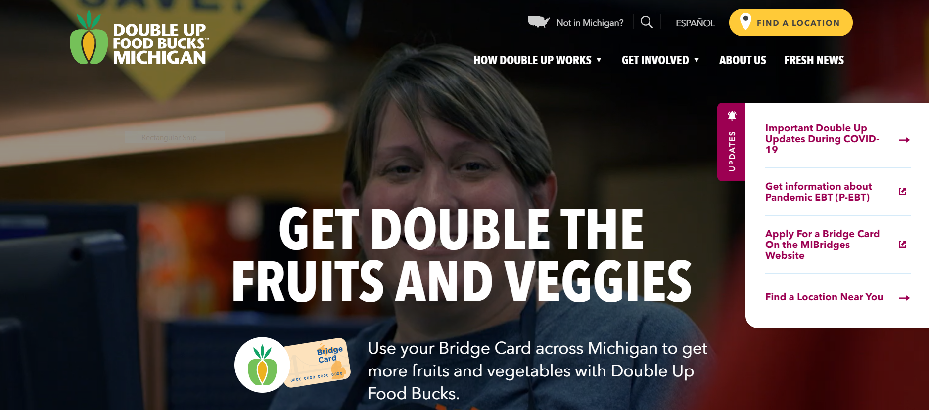
DoubleUpFoodBucks.org/get-involved
Notes:
CS

Slide 21
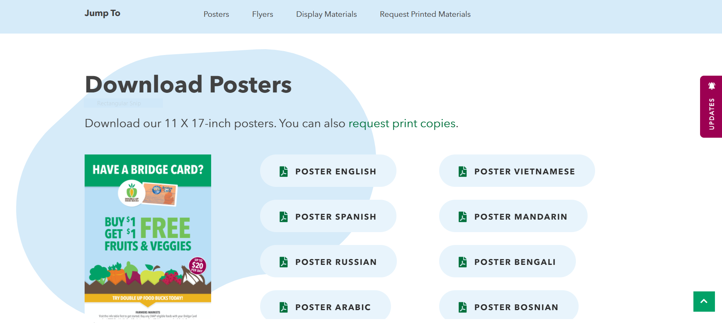
DoubleUpFoodBucks.org/get-involved/get-double-up-materials/
Notes:
CS
There are so many ways you can get involved. Start with DoubleUpFoodBucks.org: Here you can find a participating site near you, information on volunteering, and more.
We are also here to provide flyers you can share in your community.

Slide 22
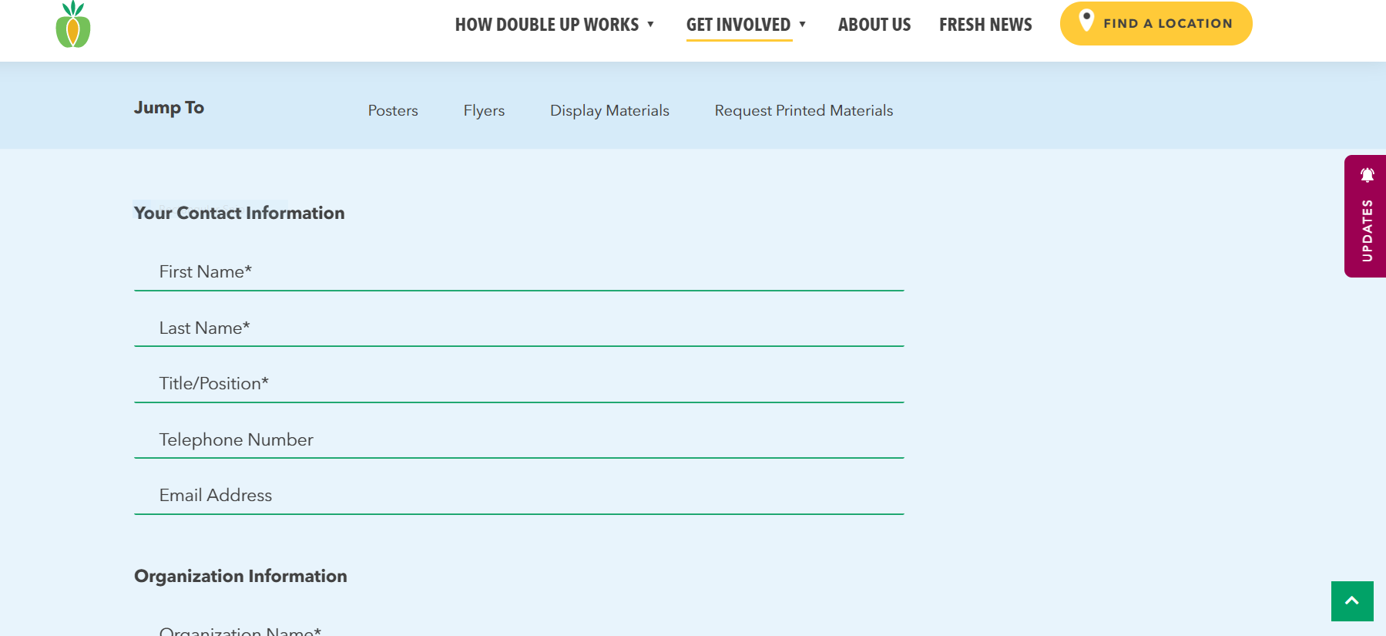
DoubleUpFoodBucks.org/get-involved/get-double-up-materials/
Notes:
CS
There are so many ways you can get involved. Start with DoubleUpFoodBucks.org: Here you can find a participating site near you, information on volunteering, and more.
We are also here to provide flyers you can share in your community.

Slide 23
Ambassador Program
Grocery Outreach
  In-store program navigation
Community Outreach
  Community events
  Partner presentations
Current Locations:
  Detroit
  Flint
  More to be determined!
Notes:
CS
• Introducing community members to Double Up and signing up new users
• Increasing awareness and usage of the Double Up
• Identifying and attending local community events & health fairs
• Sharing feedback and participating in Double Up team meetings
• Meeting bi-weekly with the Outreach and Engagement Manager
• Maintaining documentation of activities, implementation, and outcomes

Slide 24

Building Customer Excitement |Increasing DUFB Sales
Cooking Matters at the Store
E-newsletter
Recipe cards
Cashier and store Competitions – who can do the most redemptions

Slide 25
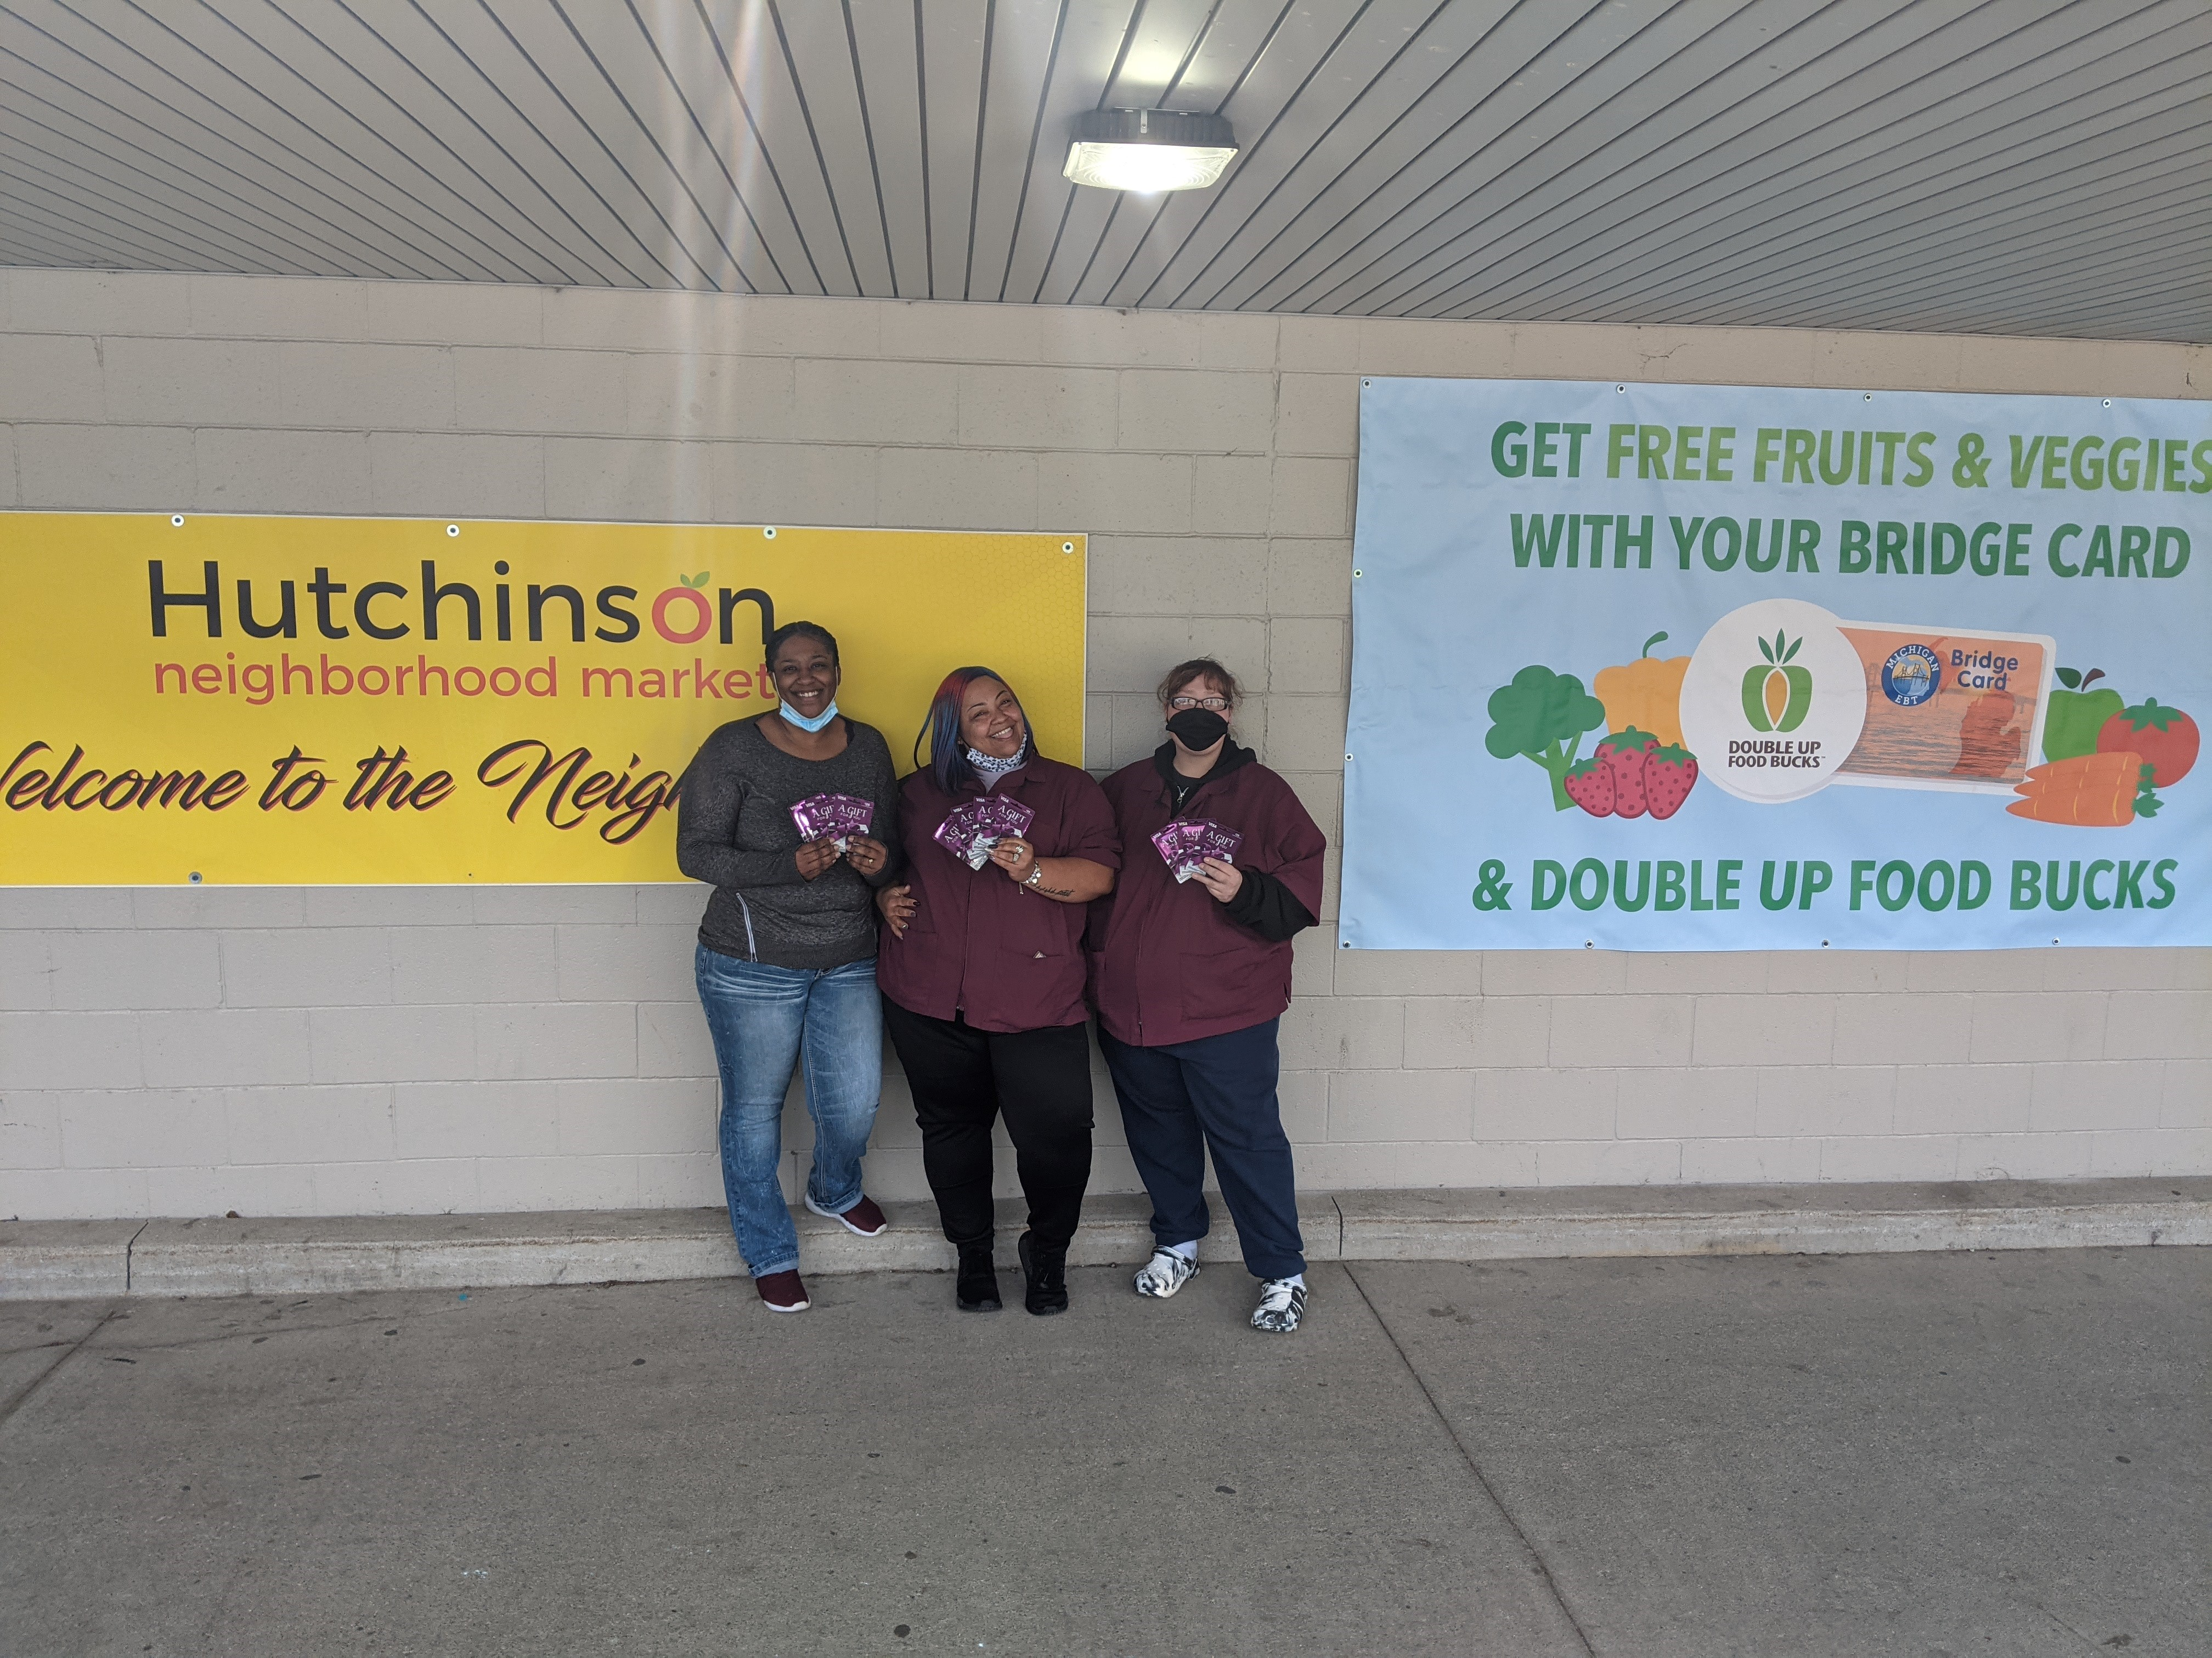
Grow Cashier Excitement | Cashier Competitions
50%-60% increase in redemptions
Incentivized/encouraged training
Increased sign ups
Heighten customer experience
Cashiers are the key to success!
Can you run a competition?
April 2021 Double Up Challenge Winners!
Notes:
CS

Slide 26
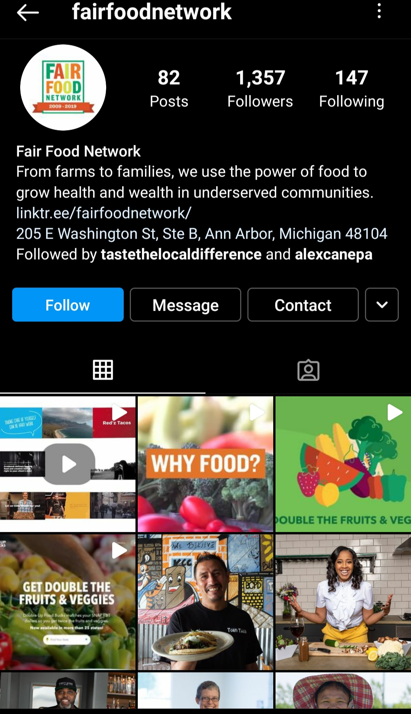
Marketing & Social Media
Facebook posts regularly updated statewide.
DoubleUpFoodBucks.org has a link to your website.
Detroit mailers sent in May.
Mailers for Flint & Grand Rapids planned for November.
Google AdWords runs statewide.
Geofencing in Detroit, Flint & Grand Rapids.
  Running January to June
  Shoppers receive Double Up ads on phone when close to geofenced locations.
  Targets: health centers, food pantries, non-profits & human service organizations.
Notes:
CS
From MB: talking points that would be helpful for someone to share are the following : tag Double Up Food Bucks Michigan on Facebook so we can share and help promote your store, feel free to use the posts and how it works videos linked in the toolkit to talk about Double Up, and if you need to download or request new materials, visit: https://doubleupfoodbucks.org/get-involved/get-double-up-materials/
Facebook posts regularly updated statewide
Our new website has a link to your store.
Detroit Mailers were sent out to Detroit homes in May with plans to send more mailers out to the Flint area and Grand Rapids area as well in November.
Google AdWords runs statewide.
Geofencing began in January and will run until June in Detroit, Flint and Grand Rapids. Shoppers are served up Double Up ads on their phone when they are close to a geofenced location.
We’ve targeted health centers, food pantries and non-profits/human service organizations.

Slide 27
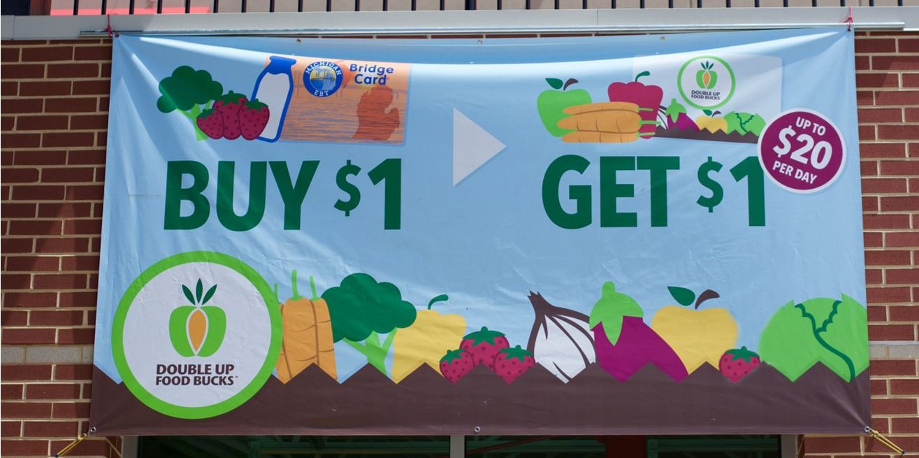
Questions?
Charles Walker
Retail Specialist | cwalker@fairfoodnetwork.org
Kendra Valkema
Information Manager | kvalkema@fairfoodnetwork.org
Carlos Santacruz
Community Engagement Manager | csantacruz@fairfoodnetwork.org
Emily Case
Incentive Technology Manager | ecase@fairfoodnetwork.org
Kellie Boyd
Program Director, Double Up Food Bucks | kboyd@fairfoodnetwork.org
Cassidy Strome
Market & Direct Site Manager| cstrome@fairfoodnetwork.org
Ricardo Ortiz
Participant Engagement Coordinator| rortiz@fairfoodnetwork.org
Holly Parker
Senior Director of Programs| hparker@fairfoodnetwork.org

